Slide 1
Machine Learning Algorithms
Linear Regression, Logistic Regression, Decision Trees, Support Vector Machines

Slide 2
Machine Learning Algorithms
Machine learning algorithms are essentially sets of instructions that allow computers to learn from data, make predictions, and improve their performance over time without being explicitly programmed.
Machine learning algorithms are broadly categorized into three types:
Supervised Learning: Algorithms learn from labeled data, where the input-output relationship is known.
Eg. Linear Regression, Logistic Regression, Decision Trees, SVM
Unsupervised Learning: Algorithms work with unlabeled data to identify patterns or groupings.
Eg. Clustering, Dimensionality Reduction, Association Rule
Reinforcement Learning: Algorithms learn by interacting with an environment and receiving feedback in the form of rewards or penalties.
Eg. Model-Based Methods, Model Free Methods

Slide 3
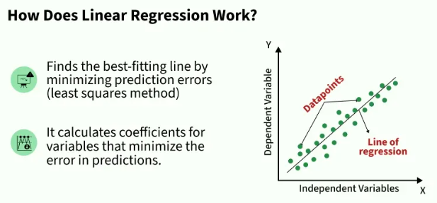
Linear Regression
Linear regression is a type of supervised machine-learning algorithm that learns from the labelled datasets and maps the data points with most optimized linear functions which can be used for prediction on new datasets.
For example :- we want to predict a student's exam score based on how many hours they studied.
We observe that as students study more hours, their scores go up.
In the example of predicting exam scores based on hours studied.
Independent variable (input): Hours studied because it's the factor we control or observe.
Dependent variable (output): Exam score because it depends on how many hours were studied.
We use the independent variable to predict the dependent variable.

Slide 4
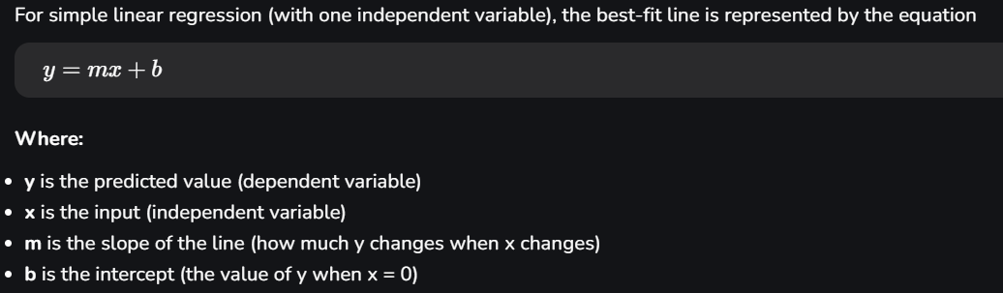
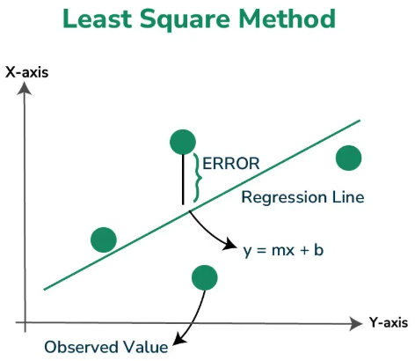
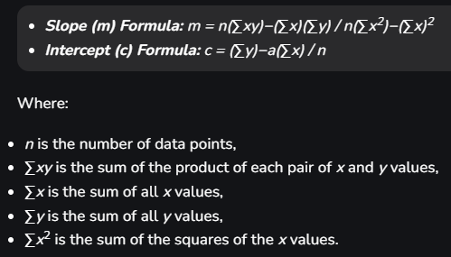
Linear Regression: Equation for Best Fit Line
Linear Regression: Least Square Method
The best-fit line will be the one that optimizes the values of m (slope) and b (intercept) so that the predicted y values are as close as possible to the actual data points.
To find the best-fit line, we use a method called Least Squares.
The idea behind this method is to minimize the sum of squared differences between the actual values (data points) and the predicted values from the line.

Slide 5
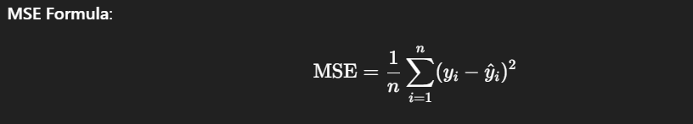
Linear Regression: Why Cost Function is Used?
Measures model accuracy → Quantifies how far predicted values are from actual values..
Guides learning process → Helps the optimization algorithm (e.g., gradient descent) know how to adjust weights.
Objective for minimization → The model tries to find the line (or hyperplane) with the least prediction error.
Ensures best fit → Minimizing the cost function produces parameters that best represent the relationship between input features and the target.
Common choice: Mean Squared Error (MSE) because it:
Penalizes larger errors more heavily (squares them).
Is smooth and differentiable (good for gradient-based optimization).

Slide 6
Linear Regression: Use Cases
Finance & Economics
Stock price prediction – Predict future prices based on historical trends.
Sales forecasting – Estimate future revenue from past sales data.
House price estimation – Predict property value based on area, location, etc.
Healthcare
Medical cost prediction – Estimate insurance charges based on age, BMI, etc.
Length of hospital stay – Predict number of days a patient will stay admitted.
Disease progression modeling – Track disease stages (e.g., blood pressure over time).
E-commerce & Retail
Revenue prediction – Estimate future earnings based on marketing spend.
Product pricing optimization – Predict ideal price point for maximum profit.
Demand forecasting – Predict quantity of product needed based on seasonality.

Slide 7
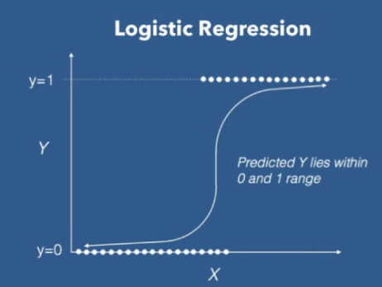
Logistic Regression
Logistic Regression is a supervised machine learning algorithm used for classification problems.
Unlike linear regression which predicts continuous values it predicts the probability that an input belongs to a specific class. It is used for binary classification where the output can be one of two possible categories such as Yes/No, True/False or 0/1.
It uses sigmoid function to convert inputs into a probability value between 0 and 1.

Slide 8
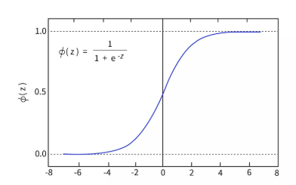
Logistic Regression: Sigmoid Function
The sigmoid function is a important part of logistic regression which is used to convert the raw output of the model into a probability value between 0 and 1.
This function takes any real number and maps it into the range 0 to 1. Because probabilities must lie between 0 and 1, the sigmoid function is perfect for this purpose.
In logistic regression, we use a threshold value usually 0.5 to decide the class label.
If the sigmoid output is same or above the threshold,
the input is classified as Class 1.
If it is below the threshold, the input is classified as Class 0.

Slide 9
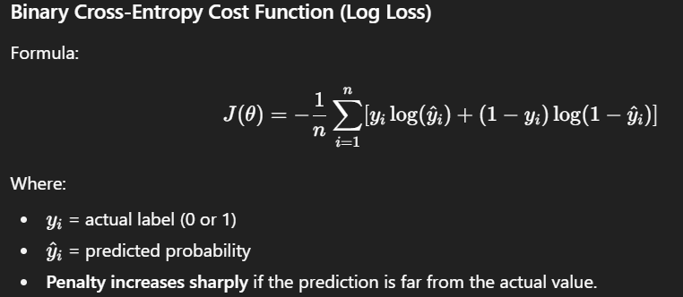
Logistic Regression: Why Cost Function is Used?
Measures Prediction Error
Tells us how far our predicted probabilities are from the actual labels (0 or 1).
Guides Optimization
Acts as a goal for the model to minimize during training using algorithms like Gradient Descent.
Handles Probabilities Properly
Logistic Regression predicts probabilities (via sigmoid), so we need a cost function that works well with probabilities.
Prevents Poor Fitting
Without a cost function, the model has no feedback mechanism to improve weights.
Ensures Smooth Convergence
The chosen cost function (Binary Cross-Entropy) is convex,
which ensures optimization can find the global minimum.

Slide 10
Logistic Regression: Use Cases
Finance & Banking
Credit default prediction – Will a customer default on a loan? (Yes/No)
Fraud detection – Is a transaction fraudulent or not?
Customer churn prediction – Will a customer leave the bank or not?
Healthcare
Readmission prediction – Will a patient be readmitted within 30 days or not?
Survival analysis – Will a patient survive past a certain time frame?
E-commerce & Retail
Purchase likelihood – Will a user buy a product or not?
Click-through rate prediction – Will a user click on an ad or not?
Customer segmentation – Classify users into interested vs uninterested categories.

Slide 11
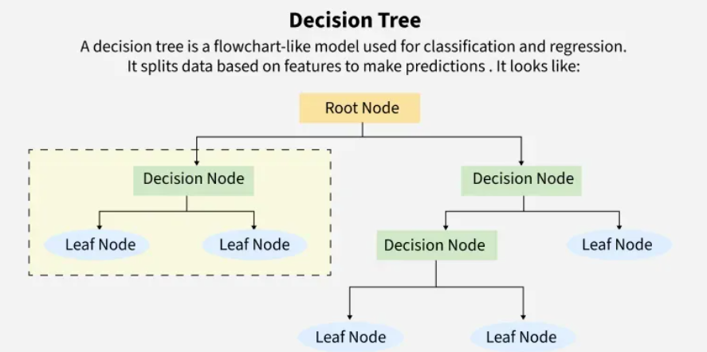
Decision Tree
A decision tree is a supervised learning algorithm used for both classification and regression tasks.
Decision trees are widely used due to their interpretability, flexibility and low preprocessing needs.
Root Node: The topmost node that starts the split.
Decision/Internal Nodes: Represent a condition on a feature.
Branches: Outcome of decision (Yes/No or True/False).
Leaf/Terminal Nodes: Final prediction/result.
Architecture Works as Follows:
Select the best feature based on criteria (like Gini or Entropy).
Split the dataset.
Repeat recursively until a stopping condition is met (e.g., max depth, min samples).

Slide 12
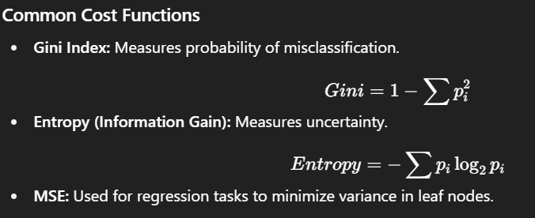
Decision Tree: Why Cost Function is used?
Guides Splitting:
The cost function measures how "pure" or "impure" a node is.
Helps decide which feature and threshold give the best split.
Maximizes Information Gain:
Chooses the split that reduces impurity the most, improving classification accuracy.
Prevents Random Splits:
Without a cost function, splits could be arbitrary and ineffective.
Works for Both Tasks:
Classification: Uses Entropy or Gini Index.
Regression: Uses Mean Squared Error (MSE).

Slide 13
Decision Tree: Use Cases
Finance & Banking
Credit risk assessment (loan approval based on financial data)
Fraud detection (identify unusual or suspicious transactions)
Customer segmentation for personalized marketing
Healthcare
Disease diagnosis (e.g., diabetes, heart disease)
Treatment recommendation based on symptoms/history
E-commerce & Retail
Product recommendation engines
Customer churn prediction
Sales forecasting using historical data

Slide 14
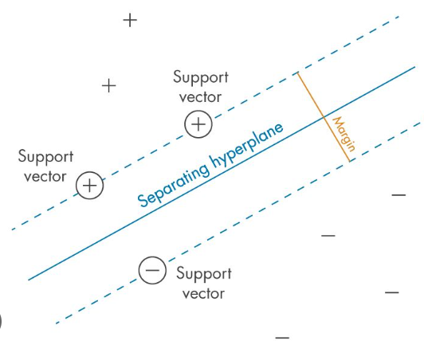
Support Vector Machine
Support Vector Machine (SVM) is a supervised machine learning algorithm used for classification and regression tasks.
It tries to find the best boundary known as hyperplane that separates different classes in the data.
The main goal of SVM is to maximize the margin between the two classes.
The larger the margin the better the model performs on new and unseen data.
Input Data → Apply kernel if needed.
Find Hyperplane → Maximize margin between classes.
Classify → Decide based on which side of hyperplane point lies.

Slide 15
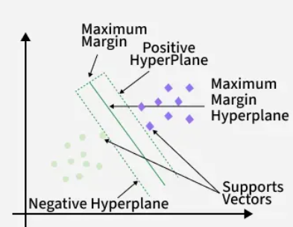
SVM: Key Concepts
Hyperplane: A decision boundary separating different classes in feature space and is represented by the equation
wx + b = 0 in linear classification.
Support Vectors: The closest data points to the hyperplane, crucial for determining the hyperplane and margin in SVM.
Margin: The distance between the hyperplane and the support vectors. SVM aims to maximize this margin for better classification performance.
Kernel: A function that maps data to a higher-dimensional space enabling SVM to handle non-linearly separable data.
Hard Margin: A maximum-margin hyperplane that perfectly separates the data without misclassifications.
Soft Margin: Allows some misclassifications by introducing slack variables, balancing margin maximization and

Slide 16
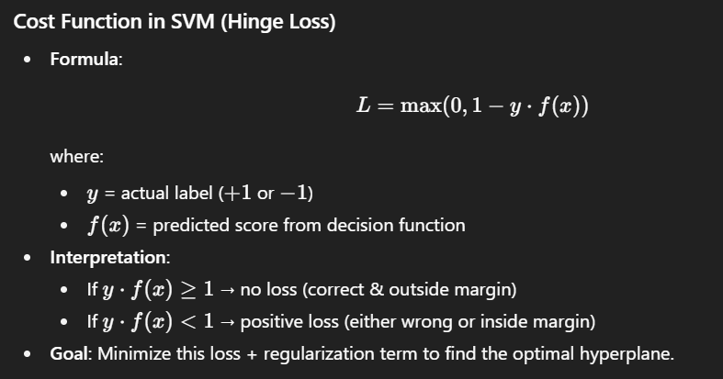
SVM: Why Cost Function is used?
Measures classification errors → Determines how far predictions are from the desired labels.
Guides the optimization → Helps the model adjust the hyperplane position to maximize margin while minimizing misclassifications.
Balances trade-off → Ensures the model finds a hyperplane that separates classes while tolerating some errors (controlled by penalty parameter CCC).
Drives learning process → The optimization algorithm minimizes this cost to improve model accuracy.

Slide 17
SVM: Use Cases
Healthcare & Bioinformatics
Disease classification – e.g., cancer detection from medical scans or gene expression data.
Tumor type identification – Classify tumors as benign or malignant.
Text & Email Classification
Sentiment analysis – Determine if a review/text is positive or negative.
Topic classification – Automatically tag documents with relevant topics.
Image Recognition & Computer Vision
Face detection – Classify regions in images as “face” or “non-face”.
Object recognition – Identify and classify simple objects in images.
E-commerce & Marketing
Customer segmentation – Group users based on behavior or purchase history.
Purchase intent prediction – Predict if a user will make a purchase or not.

Slide 18
Choosing the Right Supervised Learning Algorithm
Linear Regression
Logistic Regression
Decision Tree
SVM
When to Use
Target variable is continuous (numerical value).
Relationship between features and target is linear or close to linear.
Data has minimal outliers and not too much multicollinearity.
Best For
Predicting quantities or trends.
When to Use
Target variable is categorical (binary or multi-class).
Need probability scores for predictions.
Works well when classes are linearly separable in feature space.
Best For
Binary classification tasks with a clear decision boundary.
When to Use
Both categorical and continuous target variables.
Dataset is non-linear and has complex relationships.
Need high interpretability with if–else rules.
Best For
Handling datasets with mixed data types (categorical + numeric).
When to Use
Data has clear margins between classes.
Works well for small-to-medium datasets.
Can handle nonlinear separation with kernels.
Best For
Classification problems with high-dimensional feature spaces.

